Slide 1
steps in Strategic Planning Process
Inputs
Various organizational inputs, including the goal inputs of the claimants.
Enterprise Profile
The starting point for determining where the company is and where it should go.
Top managers clarify the firm’s geographic orientation, such as whether it should operate in selected regions, in all states.
Assess the competitive situation of their firm.
Orientation of Top Managers
Top managers, set the organizational climate, and they determine the direction of the firm.
Their values, their preferences, and their attitudes toward risks have to be carefully examined.

Slide 2
External Environment
Present and future external environment must be assessed in terms of threats and opportunities.
Evaluation focuses on economic, social, political, legal, demographic, and geographic factors.
Environment is scanned for technological developments, for products and services and for other factors necessary in determining the competitive situation.

Slide 3
Internal Environment
Firms' internal environment should be audited and evaluated in respect to its resources and its weaknesses and strengths.
Areas are: research and development, productions, procurement, marketing, and products and services.
Other factors include the assessment of human resources, financial resources, the company image, the organization structure and climate.
Planning and control system, and relations with customers.

Slide 4
Alternative Strategies
Strategic alternatives are developed on the basis of an analysis of the external and internal environment.
It may specialize or concentrate: the Korean Hyundai Company did by producing lower-priced cars (in contrast to General Motors).
Alternatively, a firm may diversify, extending the operation into new and profitable markets.
Another strategy is to go international and expand the operation into other countries.
Examines joint ventures, which may be a strategy for big undertakings in which firms have to pool their resources.
Have to adopt a liquidation strategy by terminating an unprofitable product line or even dissolving the firm.
Retrenchment strategy may be appropriate.

Slide 5
Evaluation and Choice of Strategies
must be considered in light of the risks involved in a particular decision.
Profitable opportunities may be pursued because a failure in a risky venture could result in bankruptcy of the firm.
Critical element in choosing a strategy is timing.
Medium-and Short-Range Planning, Implementation,
and Control :
Medium- and short- range planning: Various strategies have to be carefully evaluated before the choice is made.
Choices: planning as well as the implementation of the plans must be considered during all phases of the process.
Control must also be provided for monitoring performance against plans.
Consistency and Contingency: Key aspect of the strategic planning is testing for consistency and preparing for contingency plans.

Slide 6
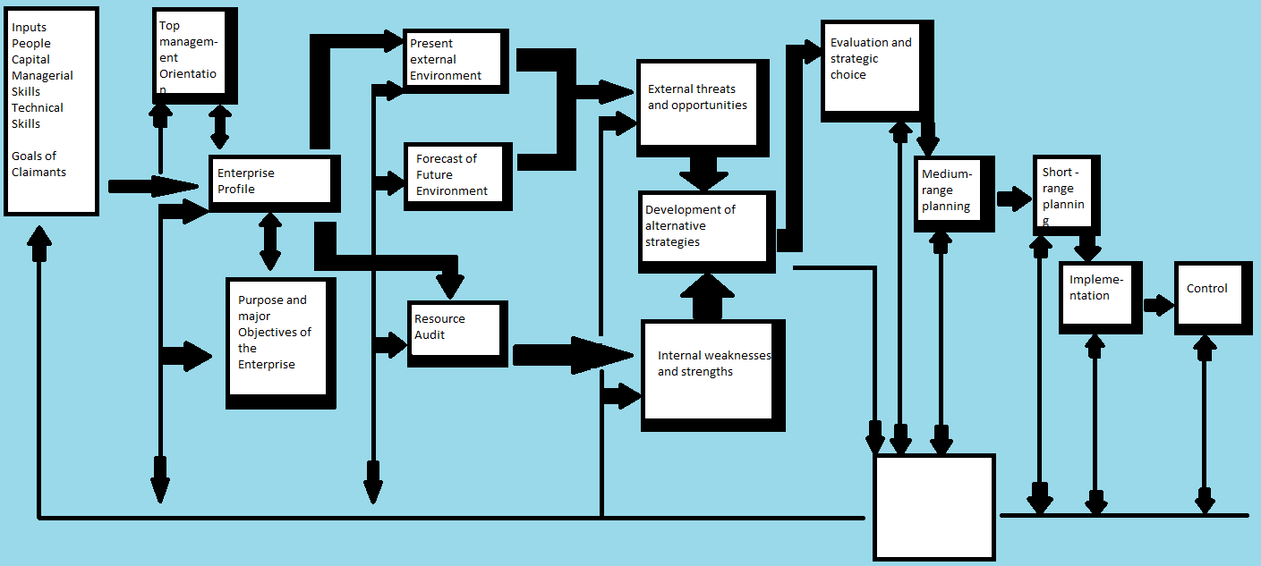
Strategic planning process

Slide 7
THE TOWS MATRIX: A MODERN TOOL FOR ANALYSIS OF THE SITUATION
Is a conceptual framework for a systematic analysis that facilitates matching the external threats and opportunities with the internal weaknesses and strengths of the organization.
Companies identify their strengths and weaknesses, as well as the opportunities and threats in the external environment.
Combining these factors may require distinct strategic choices.
“T” stands for threats
“O” for opportunities
“W” for weaknesses
“S” for strengths
TOWS model starts with the threats because in many situations a company undertakes strategic planning as a result of a perceived crisis, problem, or threat.

Slide 8
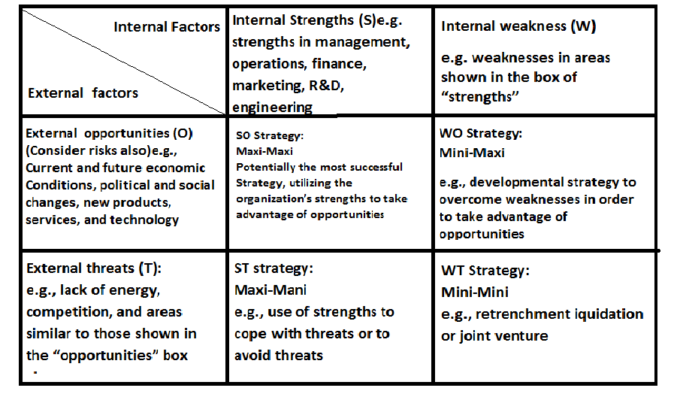
tows matrix for strategy formulation

Slide 9
Four Alternative Strategies
1. The WT strategy (in the lower right-hand corner) aims to minimize both weaknesses and threats.
For example, the company may form a joint venture, retrench, or even liquidate.
2.The WO strategy attempts to minimize the weaknesses and maximize the opportunities.
A firm may either develop those areas within the enterprise or acquire the needed competencies (technology /skills) from outside, to take advantage of opportunities.
3. ST strategy is based on the organization’s strengths to deal with threats in the environment.
The aim is to maximize the former while minimizing the latter. Use the technological ,financial, managerial, or marketing strengths to cope with the threats of a new product being introduced by it’s competitor.
4. SO strategy is most desirable as the company can use it’s strengths to take advantage of the opportunities.
They will strive to overcome the weaknesses and convert them to strengths.

Slide 10
PORTFOLIO MATRIX: A TOOL FOR ALLOCATING RESOURCES
It was developed by the Boston Consulting Group (BCG).
Shows the linkages between the growth rate of the business and the relative competitive position of the firm, identified by the market share.
Businesses in the “question marks” quadrant, with a weak market share and a high growth rate require cash investment so that it can become “stars,” the businesses in the high growth, strongly competitive position for growth and profit.
“Cash cows,” with a strong competitive position and a low growth rate, are well established in the market. Are in the position of making the products at low cost products of these enterprises provide the cash needed for their operation.
“Dogs” are businesses with a low growth rate and a weak market-share position are usually not profitable and generally should be disposed of.
Portfolio Matrix was developed for large corporations with several divisions that are often organized around strategic business units.

Slide 11
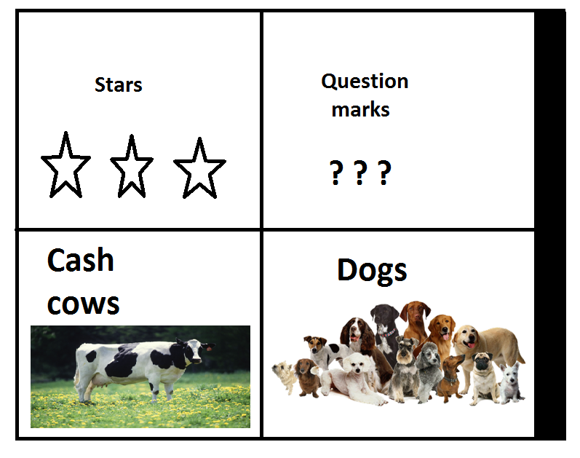
BUSINESS PORTFOLIO MATRIX
Business Growth Rate
High
Low
Strong
Weak
Relative competitive position (market share)

Slide 12
BUSINESS PORTFOLIO MATRIX - KEY QUESTIONS
Where are our customers, and why do they buy?
How do our customers buy?
How is it best for us to sell?
Do we have something to offer that competitors do not?
Do we wish to take legal steps to discourage competition?
Do we need, and can we supply, supporting services?
What are the best pricing strategy and policy for our operation?

Slide 13
MAJOR KINDS OF STRATEGIES AND POLICIES THAT GIVE DIRECTION TO OPERATIONS
Growth
Give answers to such questions as these: How much growth should occur? How fast? How should it occur?
Finance
Every business enterprise must have a clear strategy for financing its operations.
Organization
Type of organizational pattern an enterprise will use it. How centralized or decentralized should decision-making authority be?
What kinds of departmental patterns are most suitable? Staff positions be designed?
Personnel
Deal with such topics as union relations, compensation, selection, hiring, training and appraisal, as well as with special areas such as job enrichment.

Slide 14
PORTER’S THREE GENERIC COMPETITIVE STRATEGIES
1. Overall Cost Leadership Strategy
Aims at reductions in cost, based to a great extent on experience requires a large relative market share and cost-efficient facilities.
Emphasis on keeping a close watch on costs in research and development, sales, and service areas
Example: Tata Nano car, Air filters by Tata, low cost airlines, etc.
2. Differentiation Strategy
A company attempts to offer something unique in the industry in respect to products or services.
Porsche sports cars are indeed special, Rolex watches, Mercedes –Benz cars, Caterpillar Company, etc.

Slide 15
continued
3. Focused Strategy
Focused strategy concentrates on special groups of customers:
a particular product line
a specific geographic region
aspects that become the focal point of the firm’s efforts
Example: Fisher-Price to sell electronic calculators with large brightly colored buttons

Slide 16
Porter’s five forces of the competitive environment to evaluate the opportunities
Level of rivalry
2. Power of suppliers
3. Power of customers
4. Threat of substitutes
5. Threat of new entrants

Slide 17
Critical question analysis-tool
Who are our customers?
What do our customers want?
How much will our customers buy and at what price?
Do we wish to be a product leader?
Do we wish to develop our own new products?
What are the best pricing strategy and policy for our operation?

Slide 18
For establishing a marketing strategy-key questions to be answered
Where are our customers, and why do they buy?
How do our customers buy?
How is it best for us to sell?
Do we have something to offer that competitors do not?
Do we wish to take legal steps to discourage competition?
Do we need, and can we supply, supporting services?
What are the best pricing strategy and policy for our operation?

Slide 19
Levels of strategies
1.Corporate- level strategy (What business are we in?)
2. Business level-strategy or competitive strategy
(how do we compete?)
3. Functional –level strategy
(How do we support the business –level strategy?)
Example: pepsi corporation

Slide 20
Strategic business units(sbu)
Is a division or subsidiary of a firm that provides a distinct product or service and often has it’s own mission and goals.
SBU’S may develop strategies for:
Gaining competitive edge in servicing it’s customers
Determining how each functional area can best contribute to it’s overall effectiveness
Allocating resources among it’s functions

Slide 21
Successful implementation of Strategies
Communicating strategies to all key decision-making managers.
Developing and communicating planning premises.
Ensuring that action plans contribute to and reflect major objectives and strategies.
Reviewing strategies regularly.
Developing contingency strategies and programs.
Making the organization structure fit planning needs.
Continuing to emphasize planning and implementing strategy.
Creating a company climate that forces planning.

Slide 22
REASONS FOR Strategic Planning Failures
1. Managers are inadequately prepared for strategic planning.
2. The information for preparing the plans is insufficient for planning for action.
3. The goals of the organization are too vague to be of value.
4. The business units (a distinct form of organization) are not clearly identified.
5. The reviews of the strategic plans of the business units are not done effectively.
6. The link between strategic planning and control is insufficient.

